Slide 1
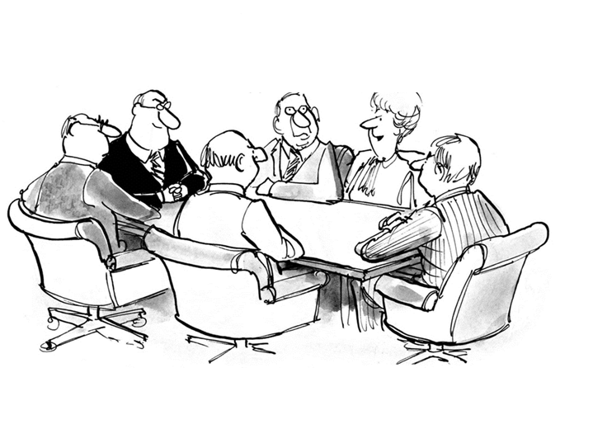
My typical day as a scientist in pre-clinical at AZ/MedI
internal
project
external
group

Slide 2
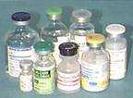
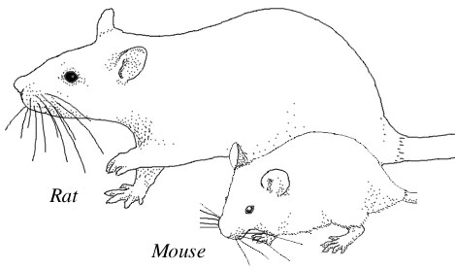
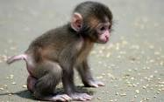
Pre-clinical function in drug development
Pre-clinical:
Drug PK/PD study in non-human primates
Toxicity study
Dose prediction for human
Clinical dose in label
DMPK (drug metabolism & pharmacokinetics):
PK (pharmacokinetics):
What the body does to the drug?
PD (pharmacodynamics):
What a drug does to the body?

Slide 3
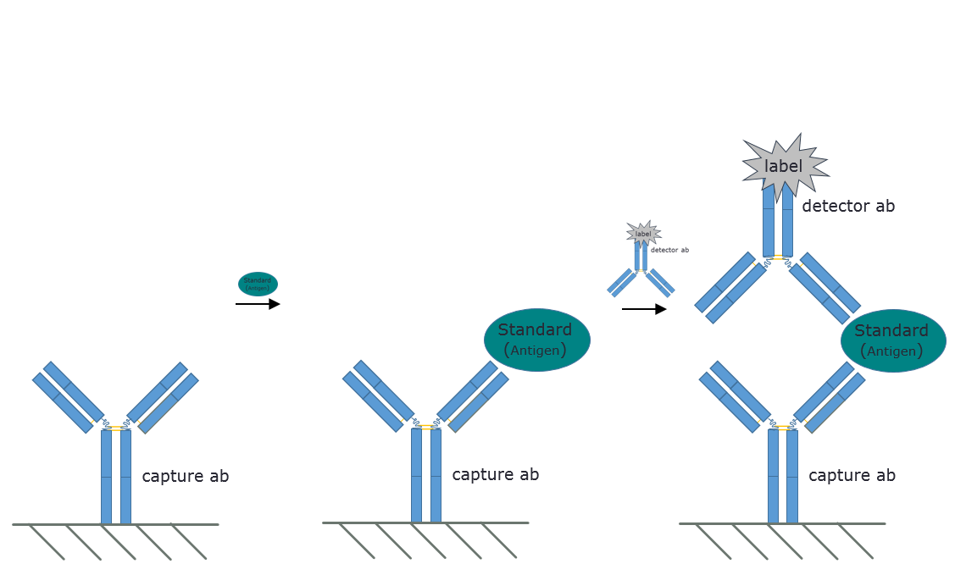
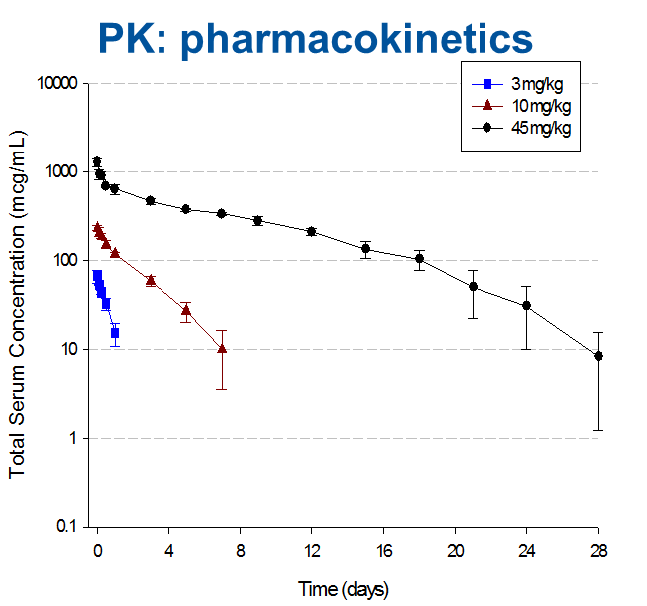
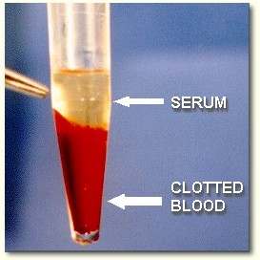
DMPK in pre-clinical study
Bioanalytical support
Develop PK/PD immunoassays to quantify drug/target in serum; Immunogenicity: anti-drug antibody; Safety/efficacy
Drug in serum
Data analysis: ½ life
Phase 1/2/3 clinical trials
Human dose selection

Slide 4
Keep strong!

